Slide 1
Crop DISEASE AND SEVERITY DETECTION AND PREDICTION OF PESTICIDES
Mentor :-
Dr. Madhavi Sinha
Team:-
ANUJ JAIN(BE/25036/14)
YASH TONGIA(BE/25030/14)
CSE –VIII Semester

Slide 2
Introduction
Each year, plant viruses and fungal attacks lead to crop losses of up to 30 percent and moreover excess usage of pesticides leads to spreading of fatal diseases such as cancer, autism and asthma.
That is why it is important to detect plant disease in its early stages. The existing methods include naked eye observations by experts. This includes constant monitoring which is very costly and a tedious exercise for large farms.
The farmers in India are less educated to understand the vulnerability and severe consequences of the diseases. They either ignore or recklessly use pesticides to get rid of the problem. This not only leads to spreading of fatal diseases and soil contamination but is also not economically beneficial for them.
Thus it is very important for them to know the disease and their proper treatment for better crop production and environmental balance.

Slide 3
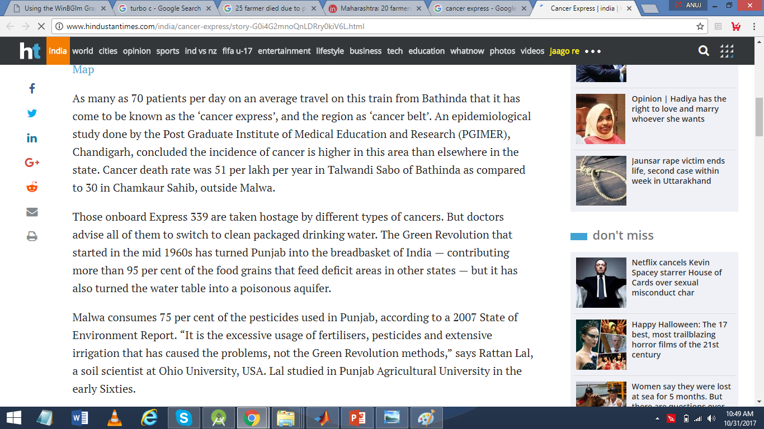
Motivation

Slide 4
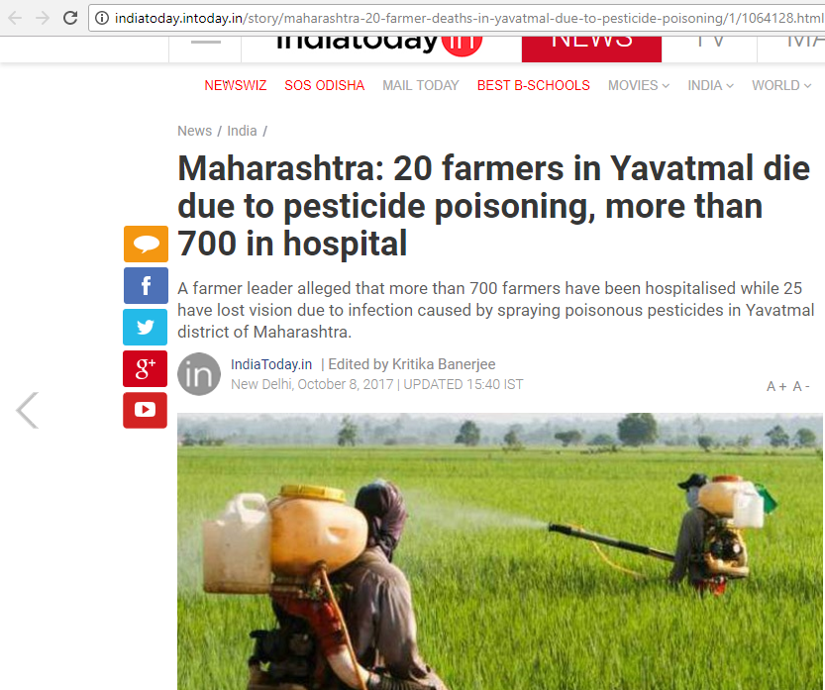

Slide 5
Objectives
The main objective of this project is to design a software tool to identify the disease with which a crop is affected using its image. The underlying objectives are explained as follows:
To apply image processing techniques to obtain affected portion of the crop and extraction of consequential feature values.
To perform comparison of extracted values with sample values to identify and classify the disease using various classifier algorithms.
To integrate and compare results of various classifier algorithms.
To predict the necessary control measures to cure the disease without any environmental and economic damage.

Slide 6
Scope
This project considers 4 major disease present in Pomegranate crop by using K-NN and Svm classification namely :-
1. Alternaria Alternata
2. Anthracnose
3. Bacterial blight
4. Cercospora leaf spot

Slide 7
Methods and Materials
The project consists of four phases which are :-
Image Acquisition and Preprocessing.
Computing the features using color co-occurrence methodology.
Classification of the disease.
Prediction of the amount of pesticides.

Slide 8
Methods and Materials
Phase 1 :-
Image acquisition is the very first step that requires capturing an image with the help of a digital camera.
Preprocessing of input image to improve the quality of image and to remove the undesired distortion from the image.
Clipping of the leaf image is performed to get the interested image region and then image smoothing is done using the smoothing filter. To increase the contrast Image enhancement is also done. Mostly green colored pixels, in this step, are masked. In this, we computed a threshold value that is used for these pixels.
Then in the following way mostly green pixels are masked: if pixel intensity of the green component is less than the pre-computed threshold value, then zero value is assigned to the red, green and blue components of the this pixel.

Slide 9
Methods and Materials
Phase 2 :-
Computing the features using color co-occurrence methodology. For feature extraction the method used is color co-occurrence method It is the methodology in which both the texture and color of an image are considered, to come to the unique features, which shows that image.
Phase 3 :-
In this phase classification, extraction and comparison of co-occurrence features for the crop leaves with the corresponding feature values stored in data set.
The following algorithms are used for the computations:
1. Support Vector Machine (SVM).
2. K-Nearest Neighbours
Phase 4 :-
Upon the classification and severity detection ,the software tool recommends the proposed measures which should be taken in order to combat the disease.

Slide 10
Expected Outcome
The software tool determines the affected region of the image and extracts the consequential values and compares them with sample data to determine and classify the disease associated with the crop and predicts the necessary control measures.
Further it also compares and analyze the outcome of various classifier algorithms.

Slide 11
IMPLEMENTATION

Slide 12
PREPROCESSING
Dataset containing images pertaining to various diseases and healthy leaves of pomegranate is taken to evaluate features associated with every image.
The features evaluated per image are stored in Taining_Data.m. The attributes of the image are numerical attributes representing these values :-
1.Mean 8.Skewness
2.Standard Deviation 9. IDM(Inverse Difference Moment)
3.Entropy 10.Contrast
4.RMS (Root Mean Square) 11.Correlation
5.Varience 12.Energy
6.Smoothness 13.Homogeneity
7. Kurtosis

Slide 13
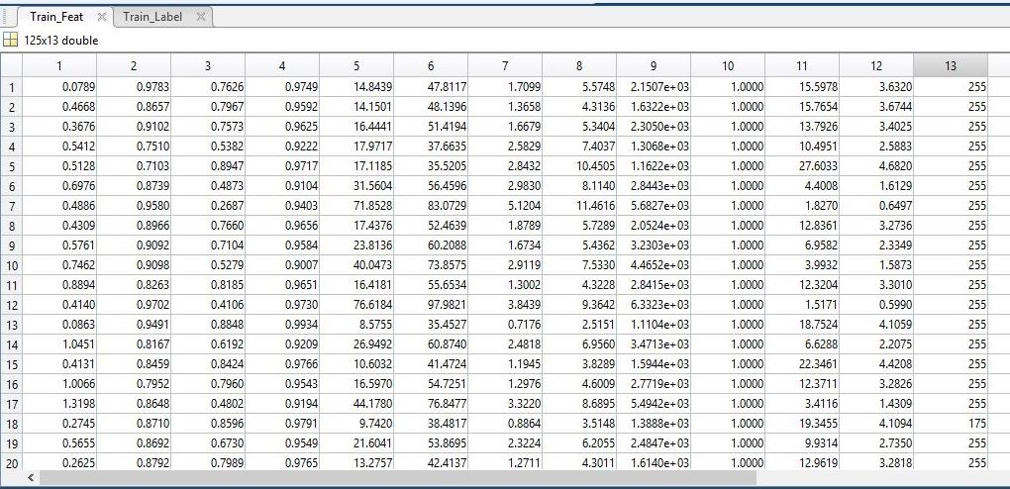
Snapshot of dataset
Source :- http://www.krishisewa.com/articles/disease-management/398-pomegranatediseases.html

Slide 14
Detection
This code segment takes an image input applies image segmentation and pre proceedings described above calculates the features of the image and send the images to the classification algorithms. Functions performed by this detection module :-
It takes the image from the user convert it into standard size, enhances contrast using color transformations.
On the contrasted image K means clustering is applied to get color segmented images which define the disease affected image.
From these segmented images the image which best represents the leaf affected is presented to the classification part.
The image features are evaluated and presented to the classifiers which in turn assigns the class label of disease to the image.
Now the affected area is analyzed to calculate percentage of infection in the leaf.
Then the results and visualized and preventive measures according to the disease are displayed.

Slide 15
SVM Classifier
The function takes training data training labels and test data to assign label to test data.
The code determines the type of disease using Multi-Class Support Vector Machine algorithm.
Multi-class classification is an important and ongoing research subject in machine learning and data mining.
For k-class problem, this method constructs k classifiers, where each one is trained on data from one class.

Slide 16
KNN Classifier
The function takes nearest neighbors, training data ,training labels and test data to assign label to test data.
The code determines the type of disease using K-nearest neighbors algorithm.
K nearest neighbors is a simple algorithm that stores all available cases and classifies new cases based on a similarity measure (e.g., distance functions).
In this case the distance function used is Euclidean Distance. KNN has been used in statistical estimation and pattern recognition already in the beginning of 1970’s as a non-parametric technique.
A case is classified by a majority vote of its neighbors, with the case being assigned to the class most common amongst its K nearest neighbors measured by a distance function.
If K = 1, then the case is simply assigned to the class of its nearest neighbor.

Slide 17
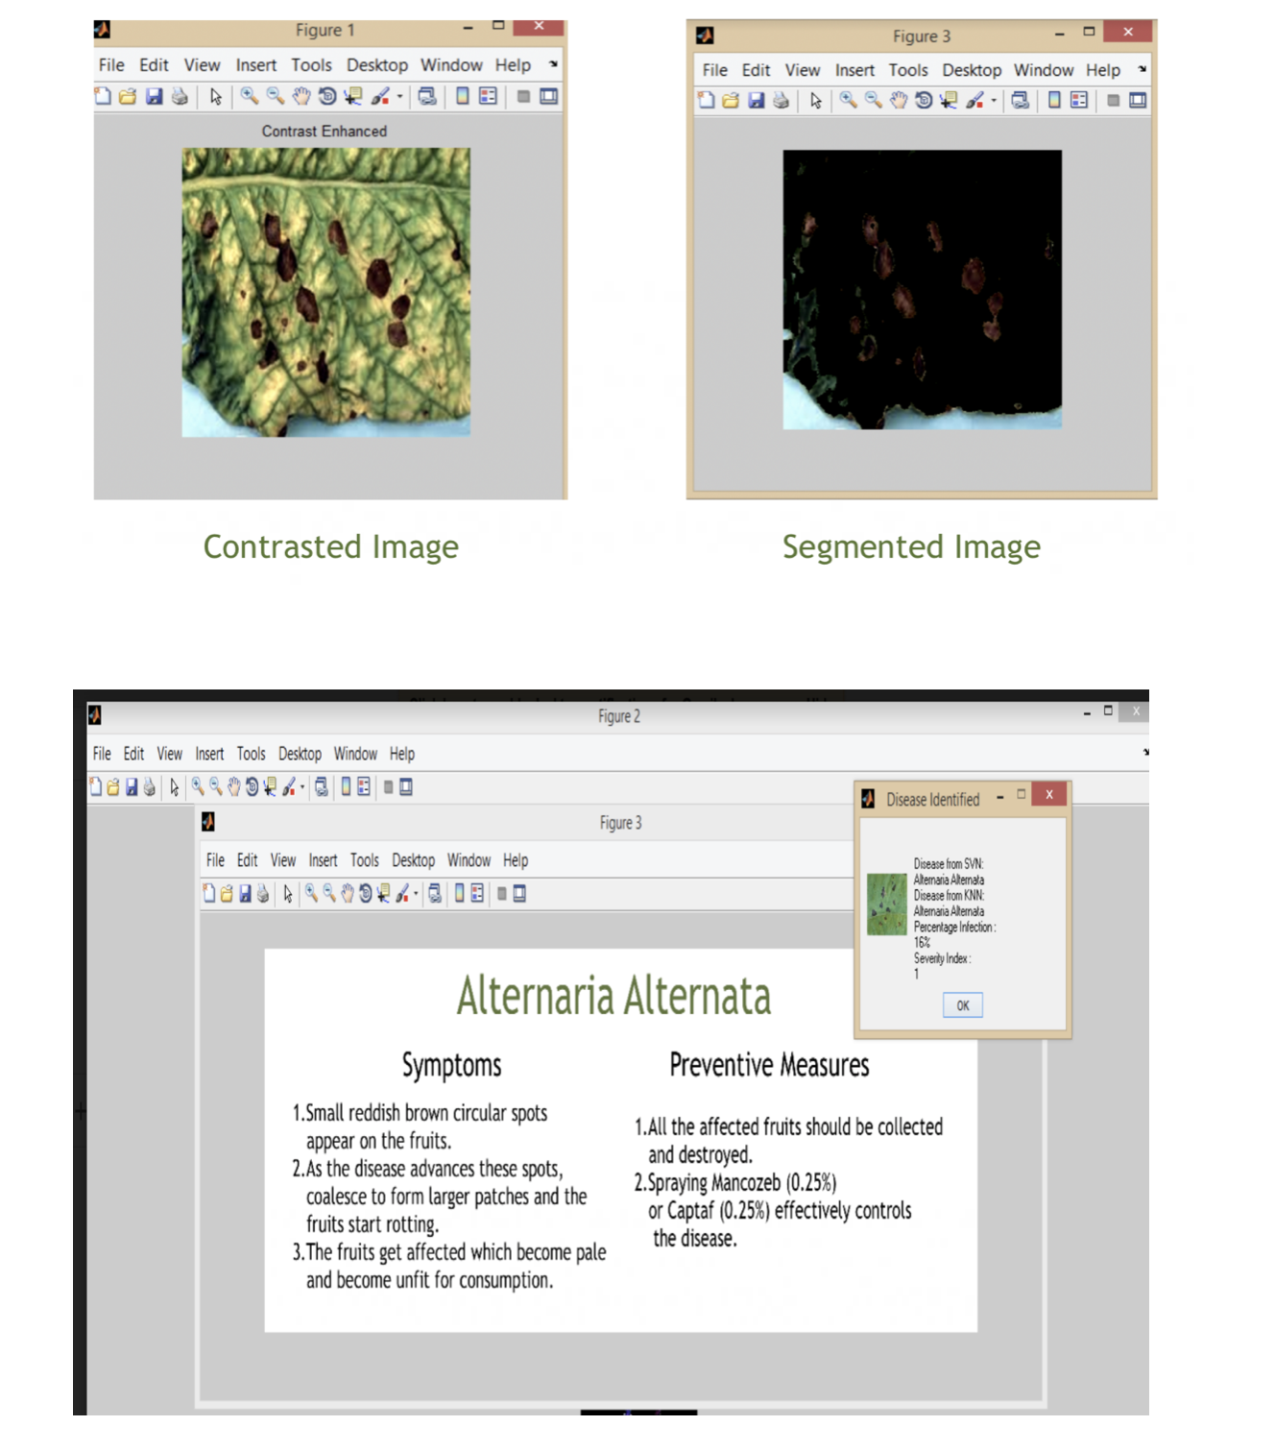
Alternaria Alternata

Slide 18
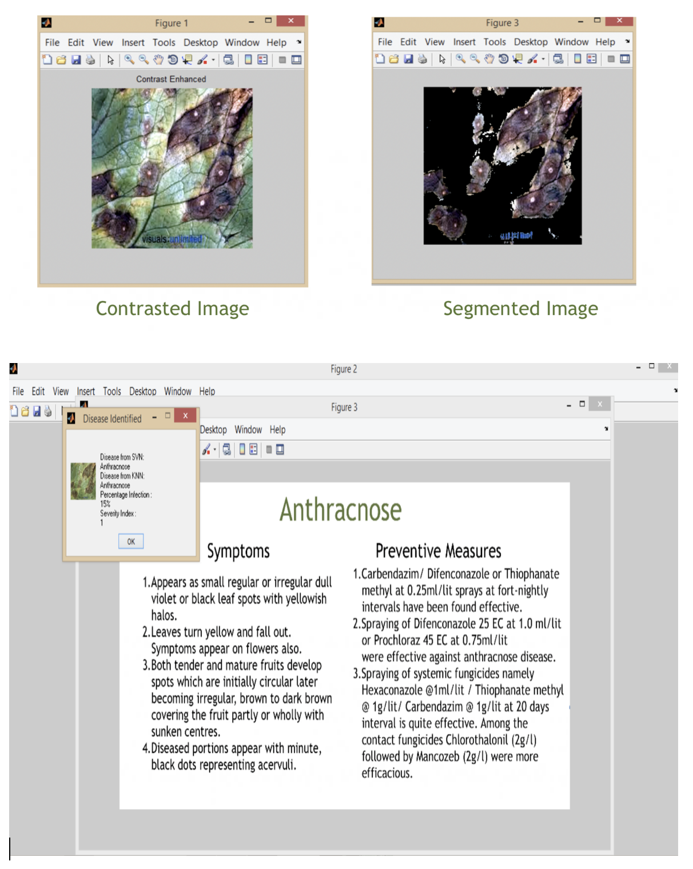
anthracnose

Slide 19
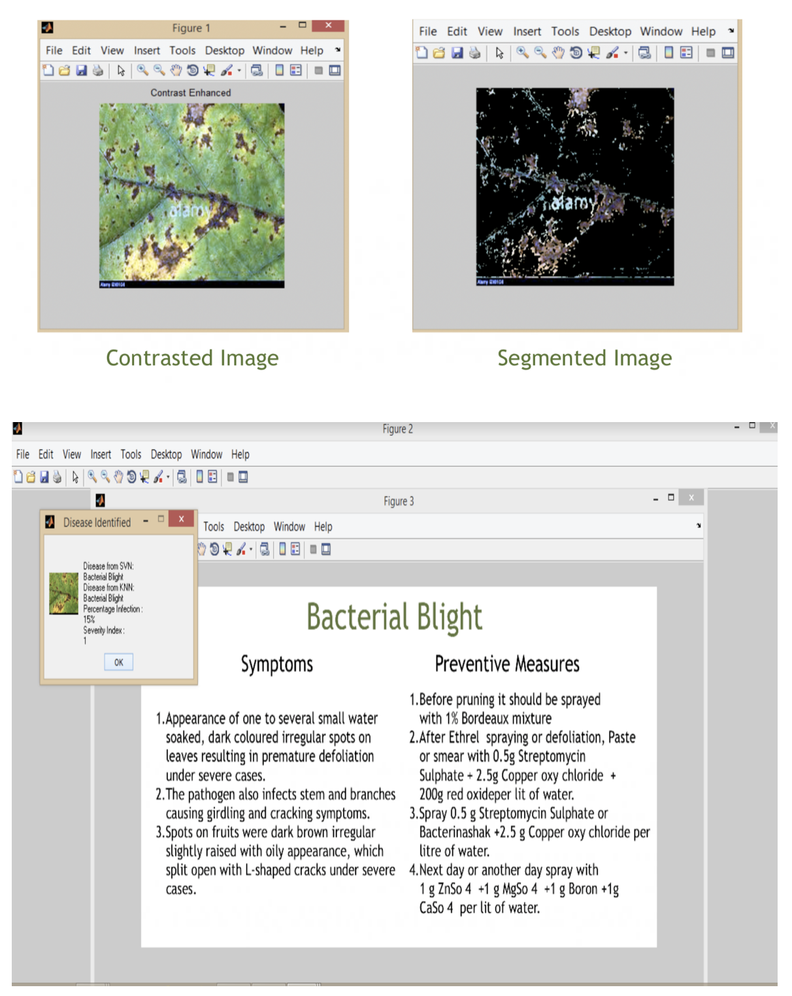
Bacterial blight

Slide 20
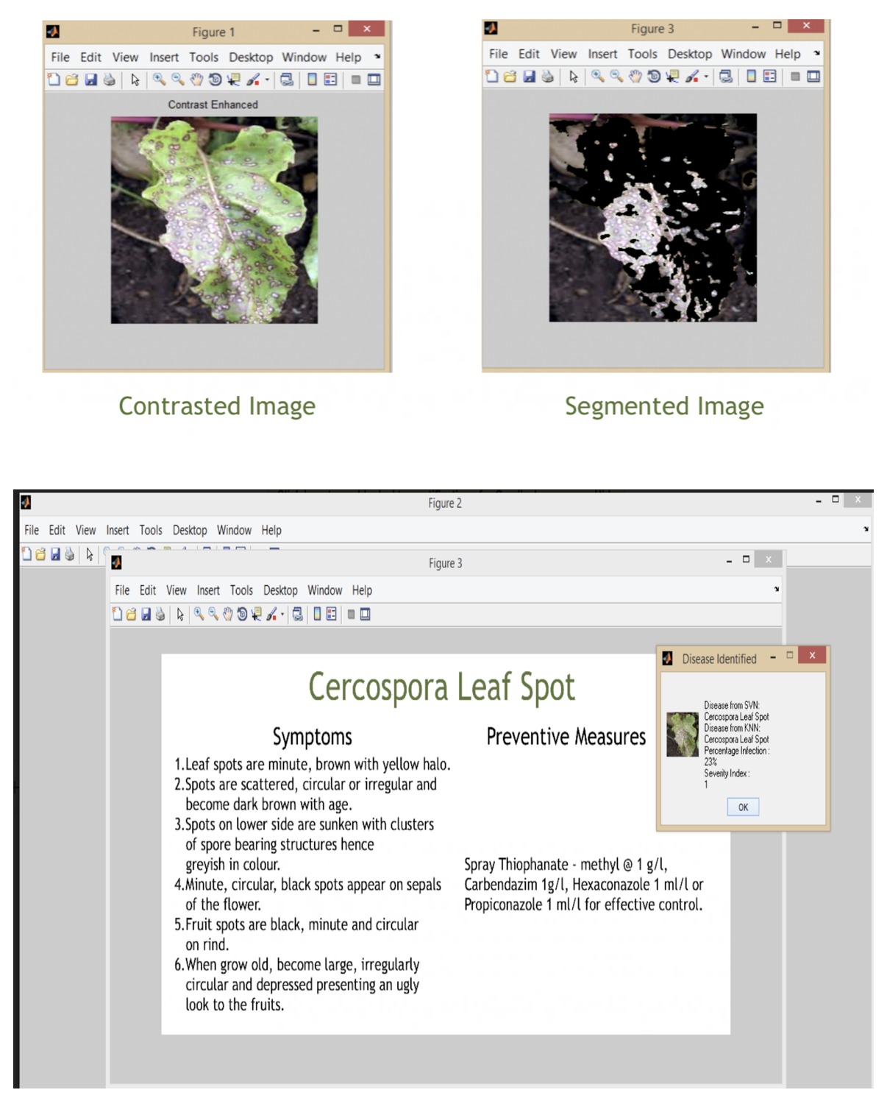
Cercospora leaf spot

Slide 21
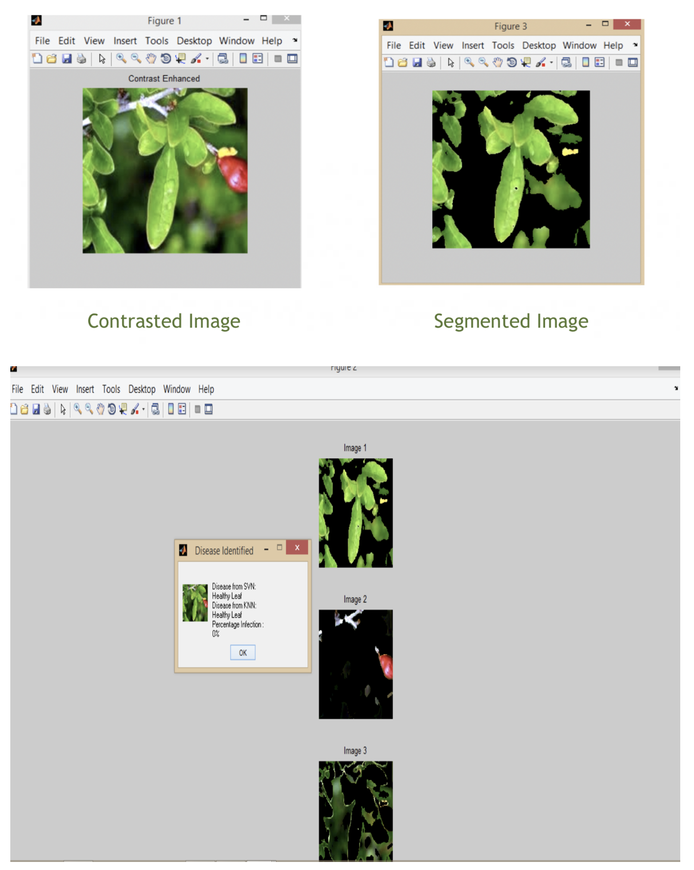
Healthy Leaf

Slide 22
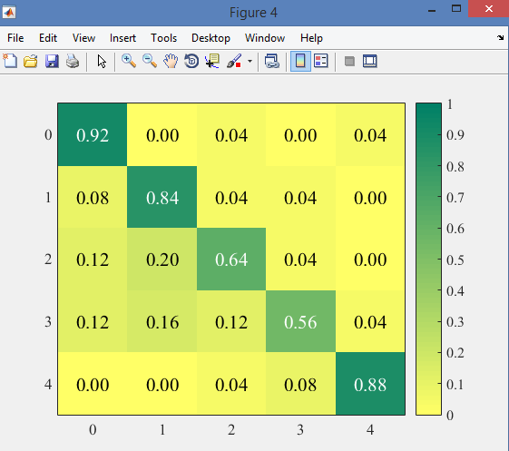
Confusion Matrix : SVM
Alternaria Alternata
anthracnose
Bacterial blight
Cercospora leaf spot
Healthy Leaf

Slide 23
Future Scope
After proper experimental observation we can also extend this project for other crops which get infected from disease severely ,very easily and can be treated by a particular type of pesticide. Ex-Citrus crops ,sugarcane ,etc.

Slide 24
References
www.catalog.data.gov/dataset?tags=plant+disease
www.reddit.com/r/datasets/comments/5uljlp/plant_leaf_disease_datasets/
www.sciencedirect.com/science/article/pii/S2214317316300154
https://pdfs.semanticscholar.org/0a10/96ca51b4b8067865211b42c0bec4c9969f34.pdf
http://www.krishisewa.com/articles/disease-management/398-pomegranatediseases.html
https://www.ijarcce.com/upload/2015/october-15/IJARCCE%20116.pdf

Slide 25
Thank you !!!

